Slide 1

Welcome to, E-Health Care Management System project presentation

Slide 2

Supervised By:- Badhan Chandra Das Lecturer Department of CSE BUBT
Here is our team
Group-04
Shuva Chowdhury-19202103215
Dipto Kumar Saha-19202103216
Habiba Rahman-19202103232
MD. Siam Hossain-19202103228
Samiul Alim-19202103211

Slide 3

OUTLINE
Introduction
Objectives
Existing literature review
Features of our project
System design
Proposed model
Software requirement
Hardware requirement
Future Plan
Conclusion
Interface and output

Slide 4

Introduction
Our project is about a system where anyone from anywhere can access their medical needs and consult with their doctors. E-healthcare system, which is getting popular all over the world is revolutionizing the medical support and saving time and making life easy.

Slide 5

Objective
Making such system that allows us to use telemedicine facilities
Allow persons to under constant monitoring of their physical conditions by healthcare professionals
Reducing physical barriers
No more time wasting
Constant medical support

Slide 6








Existing literature review

Slide 7

Easy to use interface
Day to day update
Secure chat system
24/7 service

Slide 8
Features of our project
Manage appointments with doctor remotely
Order medicine from home
Get specialists at one place
Sample collecting for tests from remote places
Online reports and prescriptions
Chat with doctors and pharmacists
Connect with administration regarding any inconvenience or trouble
User friendly interface and easy to use

Slide 9
System Design
ADMIN MODULE
DOCTOR MODULE
PATIENT MODULE
PHARMACIST MODULE

Slide 10
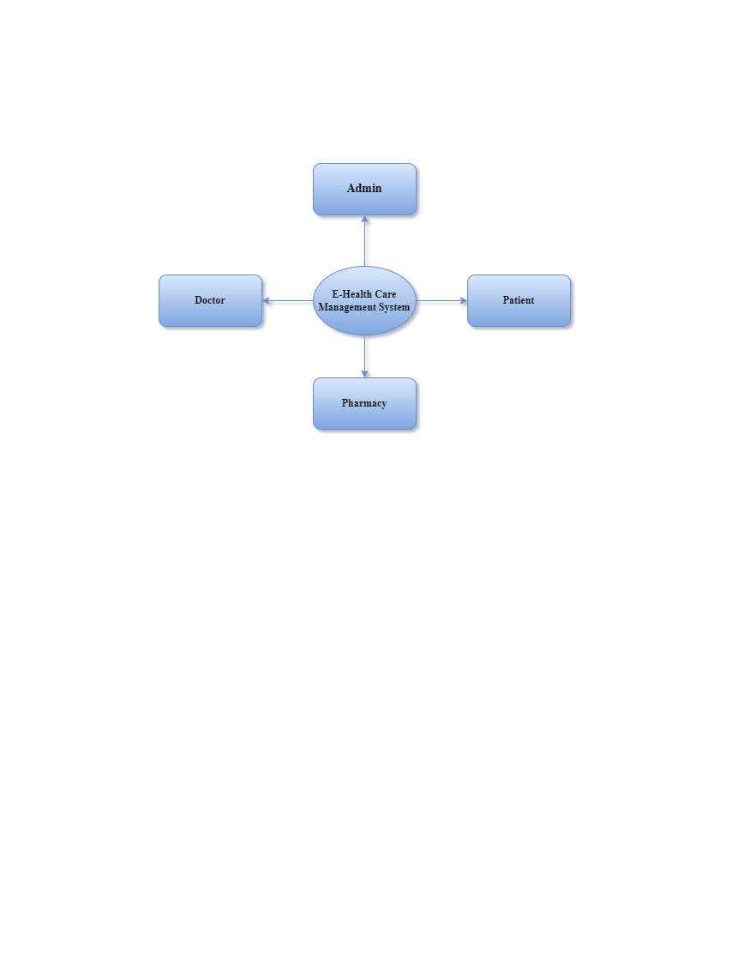
Proposed model

Slide 11
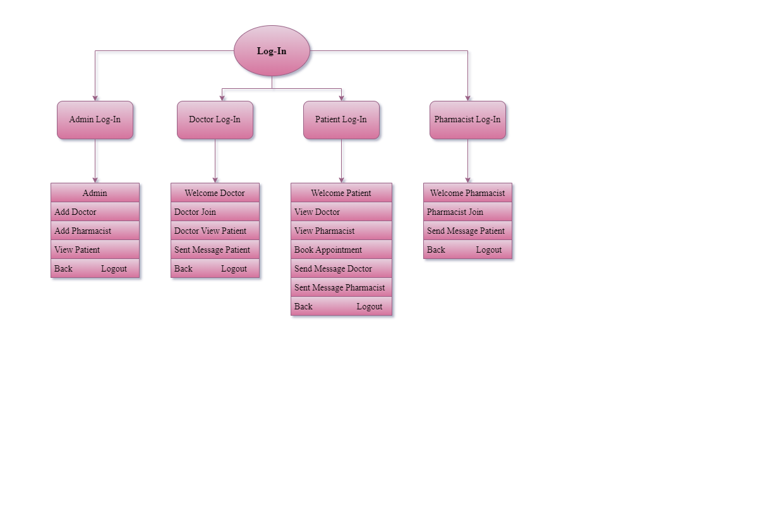
Proposed model

Slide 12
Software Requirement
OPERATING SYSTEM : WINDOWS-10
DATA BASE : MYSQL/XAMPP SEVER
SOFTWARE : Apache NetBeans
LANGUAGE : JAVA
SCRIPTING LANGUAGE : JAVA SCRIP

Slide 13
Hardware Requirements
PROCESSOR : Intel(R)Core(TM) i5-3210M
PROCESSOR SPEED : 2.50 GHZ
MONITOR : COLOR MONITOR
HARD DISK : 500GB
RAM : 8GB
MOUSE : SCROLLING MOUSE
KEY BOARD : MM KEY BOARD

Slide 14
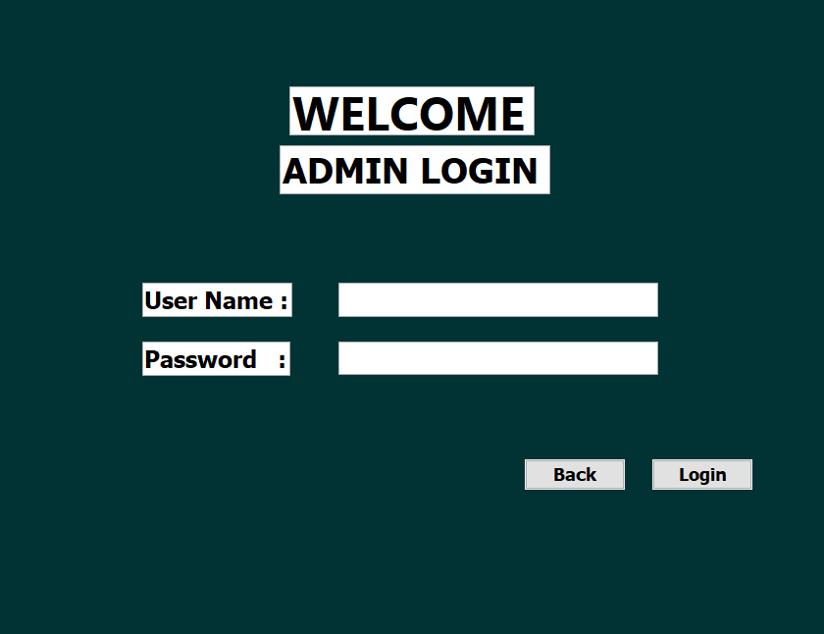
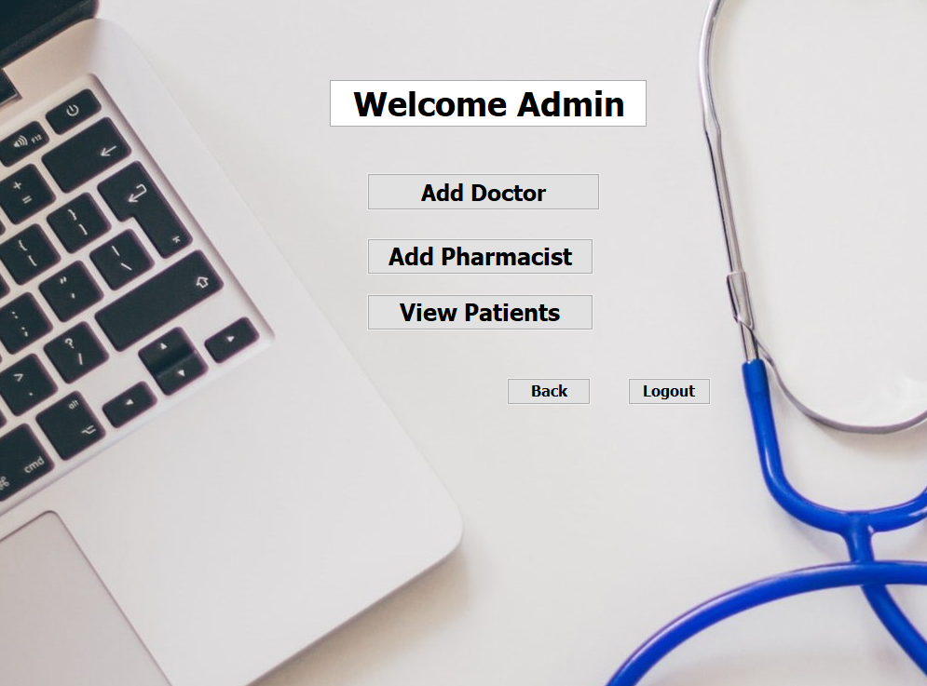
ADMIN MODULE

Slide 15
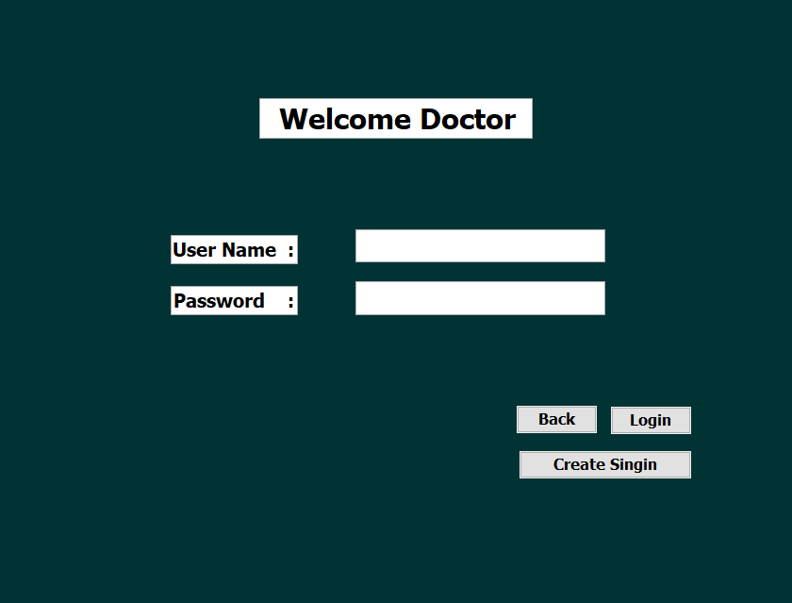
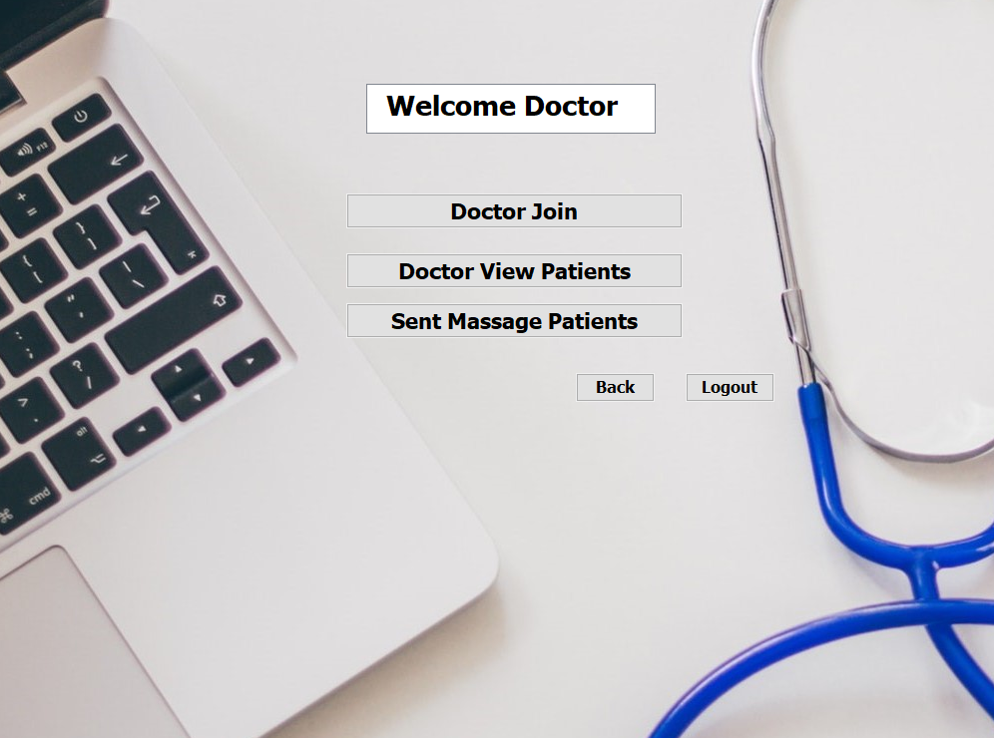
DOCTOR MODULE

Slide 16
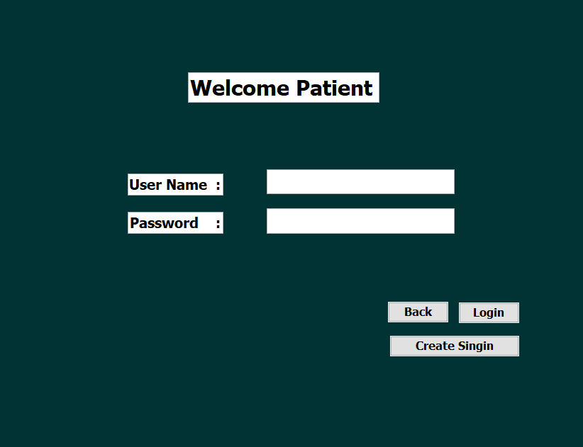
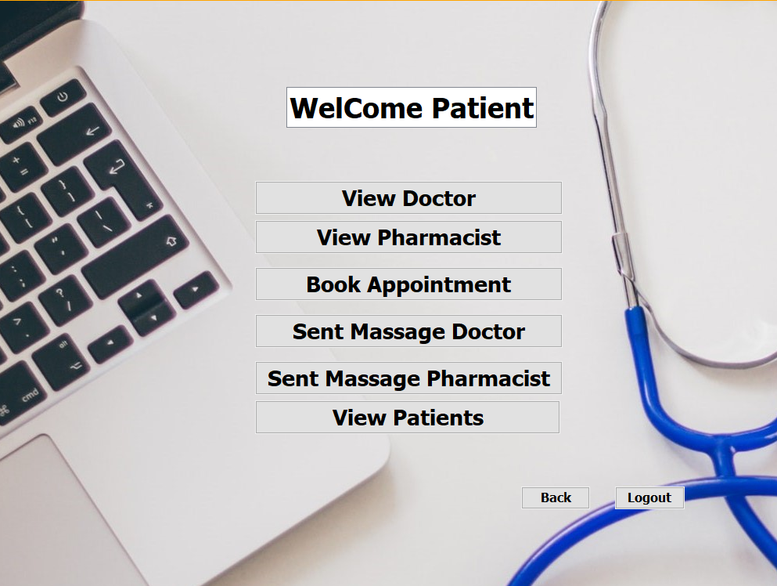
PATIENT MODULE

Slide 17
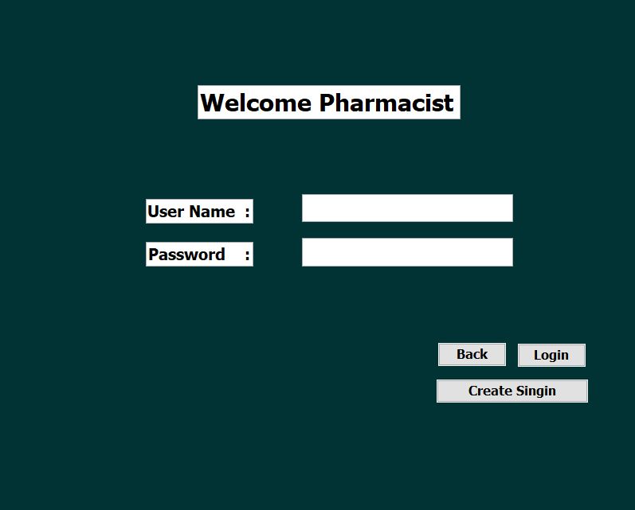
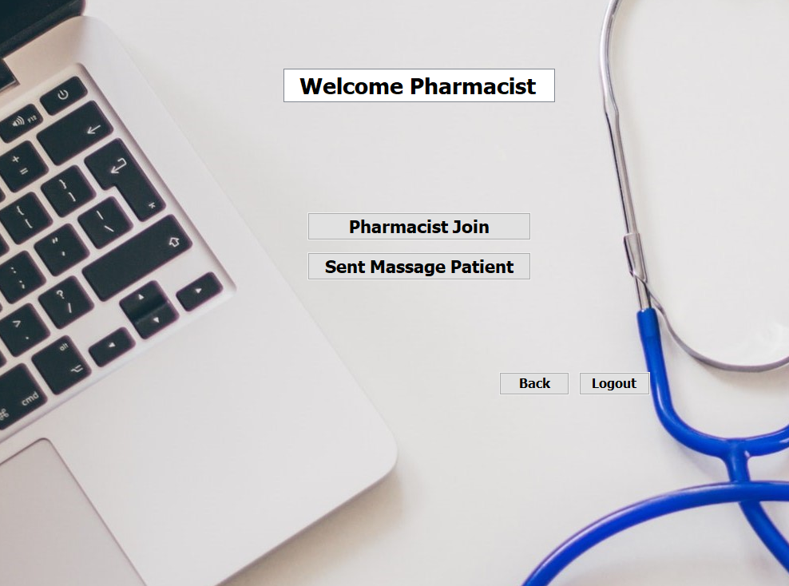
PHARMACIST MODULE

Slide 18
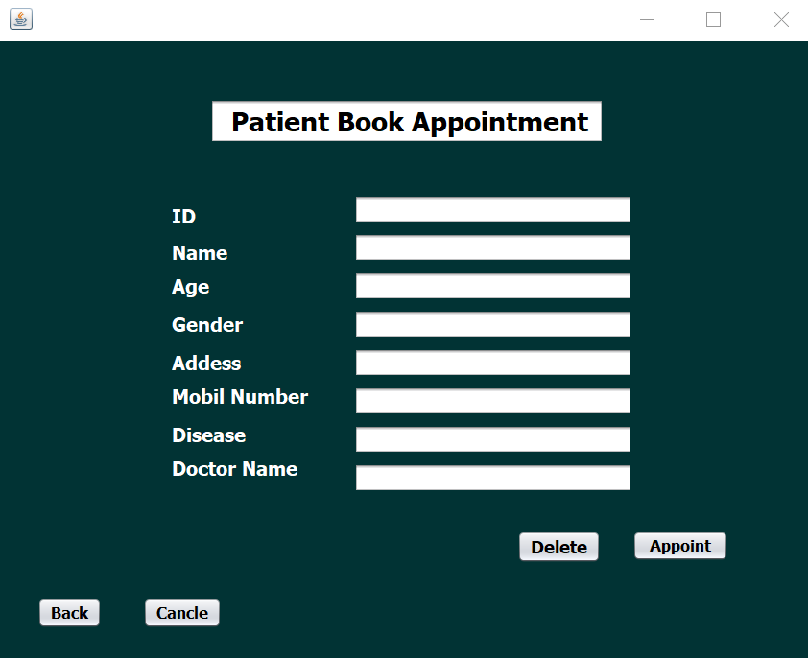
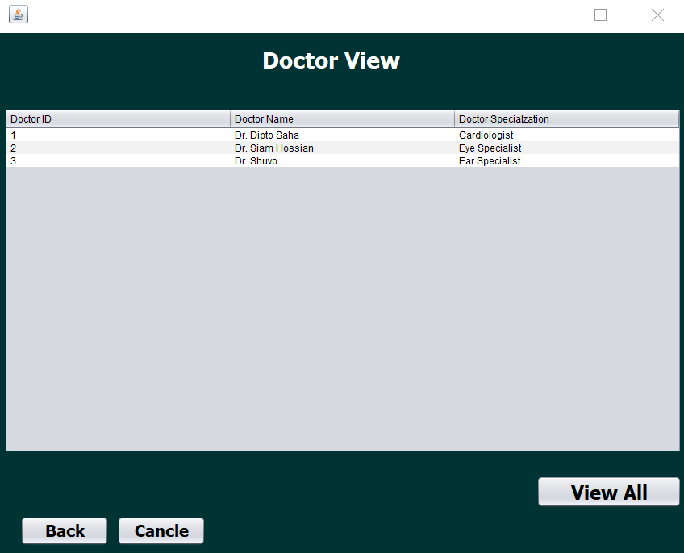
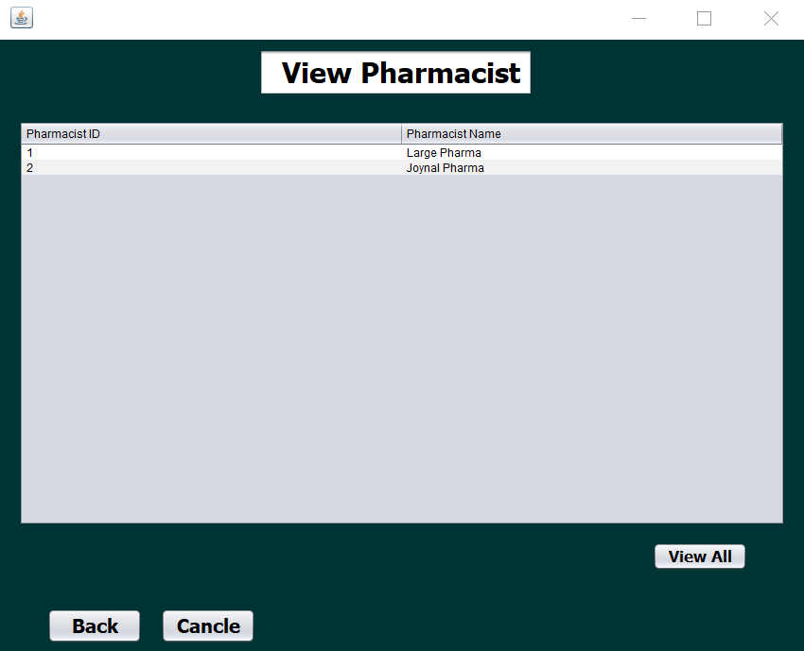
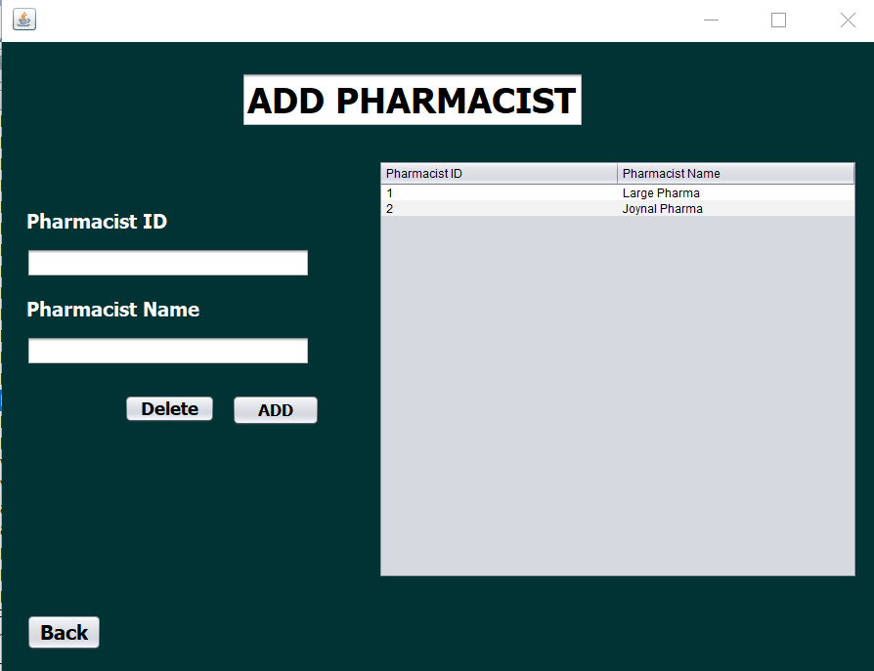
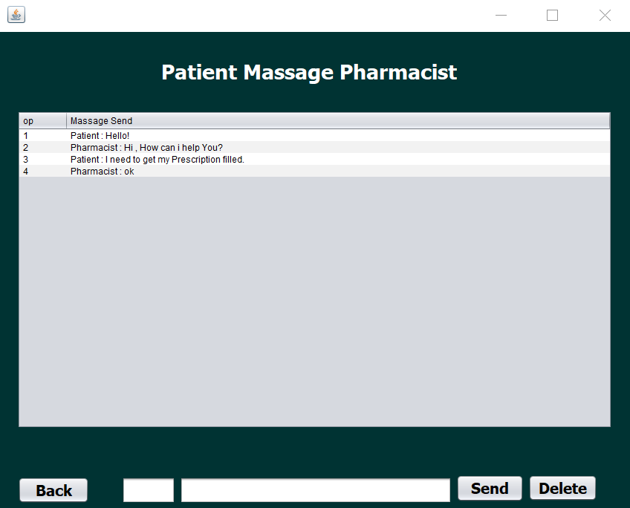
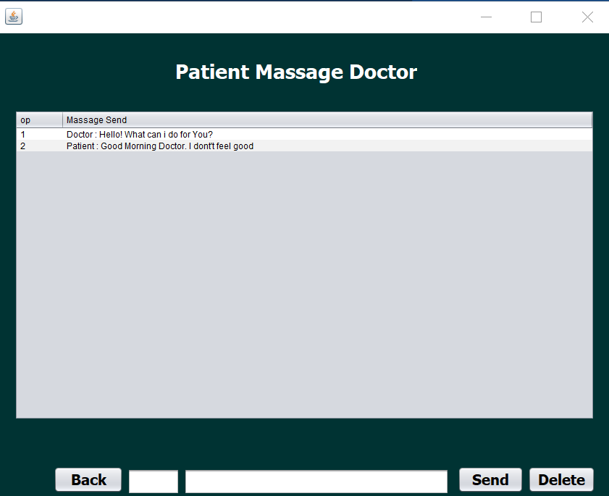
Glimpse of our project

Slide 19

Future Scopes
Adding video conferencing system
Adding features regarding security and password resetting and two factor authentication
Adding features regarding sending images
Adding maps and location system for implementing many features
Adding blood bank database

Slide 20
CONCLUSION
Digitalized medical and telemedicine systems are now a great feature of modern life. People are getting used to trying this kind of system. These are rapidly growing and bringing advancement to life.
We hope the project we did is a positive approach towards becoming digital and upgrading medical service

Slide 21


